Slide 1
BESS & PV Validation
Przemyslaw Koralewicz

Slide 2
Initial
Current controller: PI no V ff
>> tune_inverter
Iteration Func-count min f(x) Procedure
0 1 6.42365e+08
1 5 6.25669e+08 initial simplex
2 7 5.81662e+08 expand
3 8 5.81662e+08 reflect
…
239 452 3.81723e+07 shrink
240 458 3.81723e+07 shrink
241 464 3.81723e+07 shrink
onet.pl
242 470 3.81723e+07 shrink
Optimization terminated:
the current x satisfies the termination criteria using OPTIONS.TolX of 1.000000e-08
and F(X) satisfies the convergence criteria using OPTIONS.TolFun of 1.000000e-04
cc_kp_init = 0.1;
cc_Ti_init = 0.6e-3*100;
pll_kp_init = 180;
pll_ki_init = 3200;
xfind_a =
0.0439 0.5848 44.5228 472.6783

Slide 5
2nd run with VAF_pattern
Current controller: PI no V ff
>> tune_inverter
Iteration Func-count min f(x) Procedure
0 1 637940
1 5 598708 initial simplex
2 6 598708 reflect
3 8 572215 expand
4 10 538348 expand
…
163 316 461232 shrink
164 322 461232 shrink
165 328 461232 shrink
166 334 461232 shrink
167 340 461232 shrink
168 346 461232 shrink
Optimization terminated:
the current x satisfies the termination criteria using OPTIONS.TolX of 1.000000e-07
and F(X) satisfies the convergence criteria using OPTIONS.TolFun of 1.000000e-04
Found manually:
cc_kp_init = 0.2;
cc_Ti_init = 0.045;
pll_kp_init = 45;
pll_ki_init = 450;
xfind_a =
0.2511 0.0432 70.9991 270.2331

Slide 8
3rd run – tune using VFQ steps 1% / 500kW
Found manually:
cc_kp_init = 0.2;
cc_Ti_init = 0.045;
pll_kp_init = 45;
pll_ki_init = 450;
xfind_a =
0.0349 5.6689 18.1901 493.1122

Slide 9
Grid forming

Slide 10
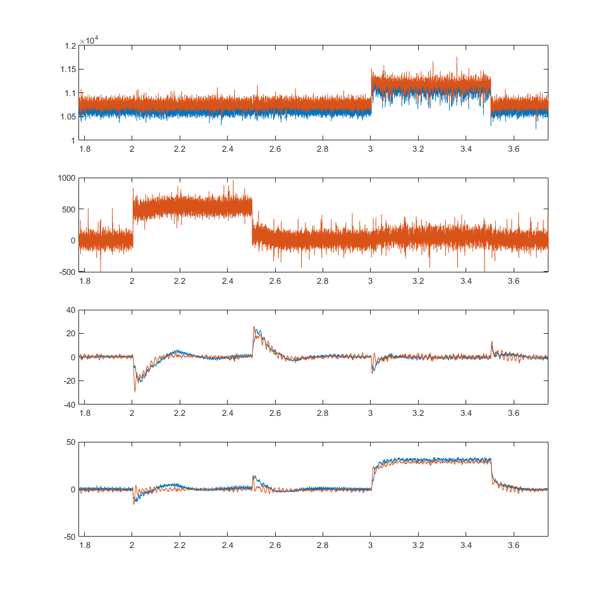
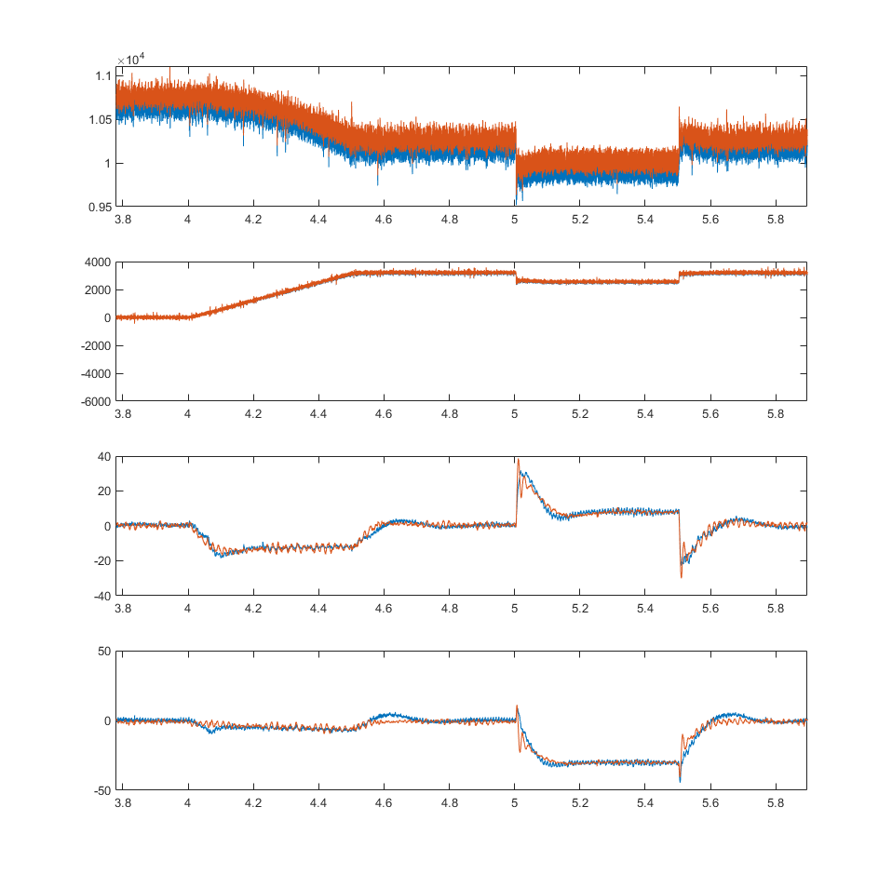

Slide 11
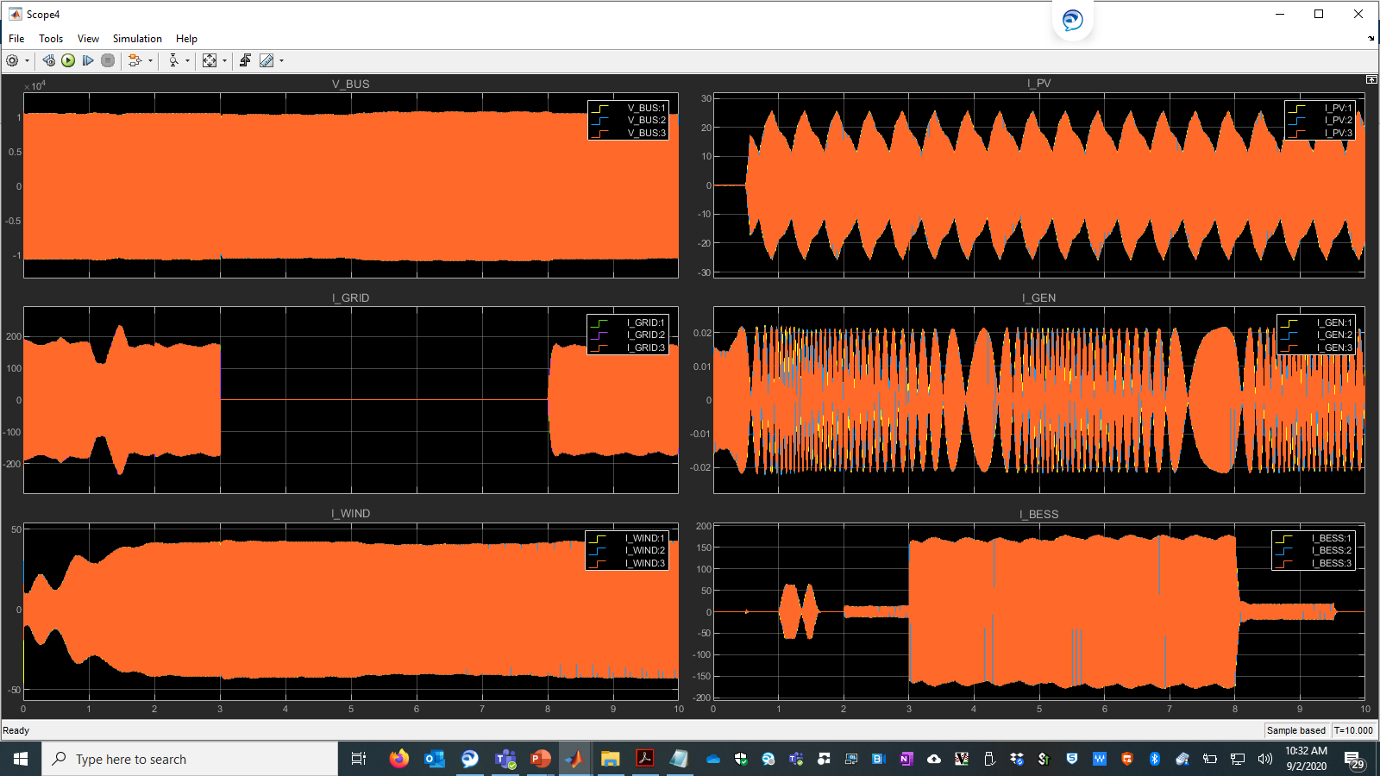
With out Genset (Open)

Slide 12
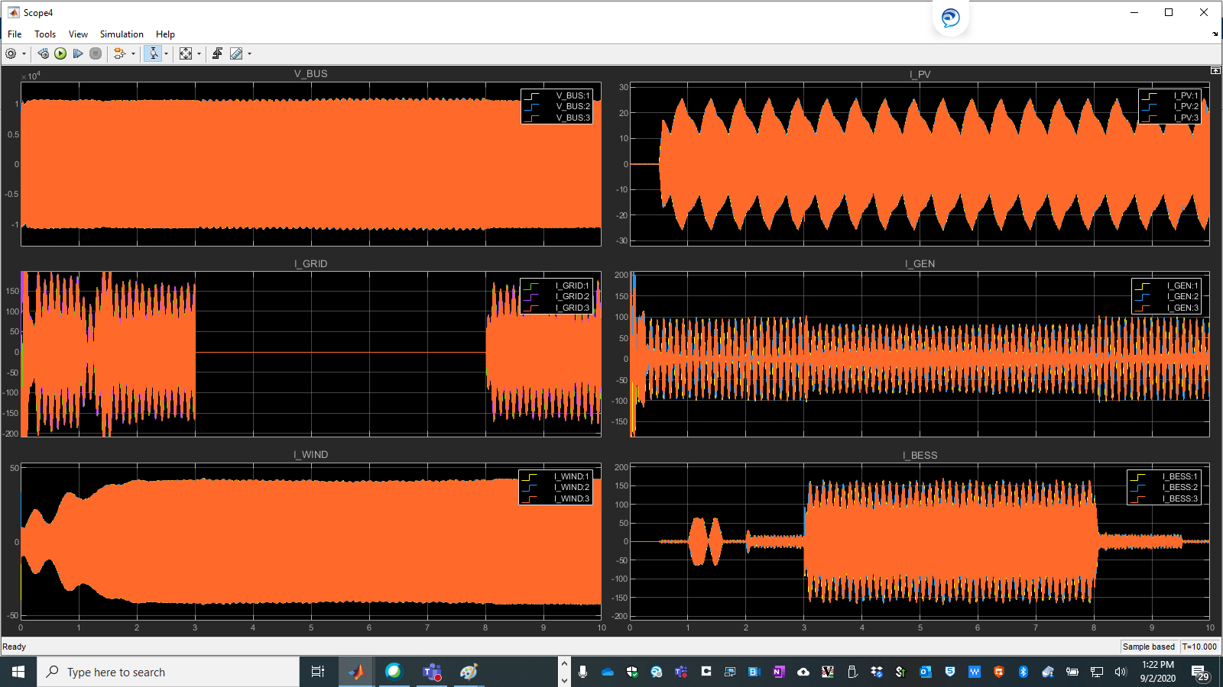
With Genset closed and Load 3 MW

Slide 13
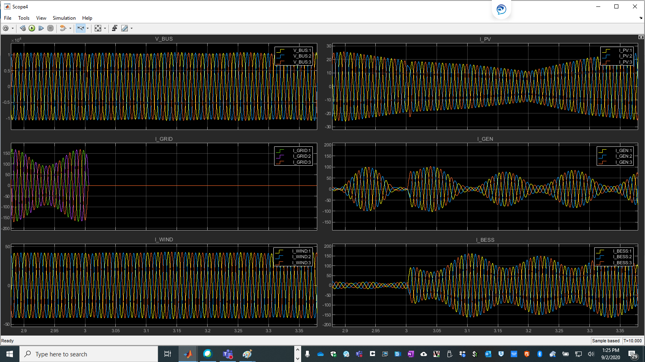
With Genset and 3 MW Load

Slide 14
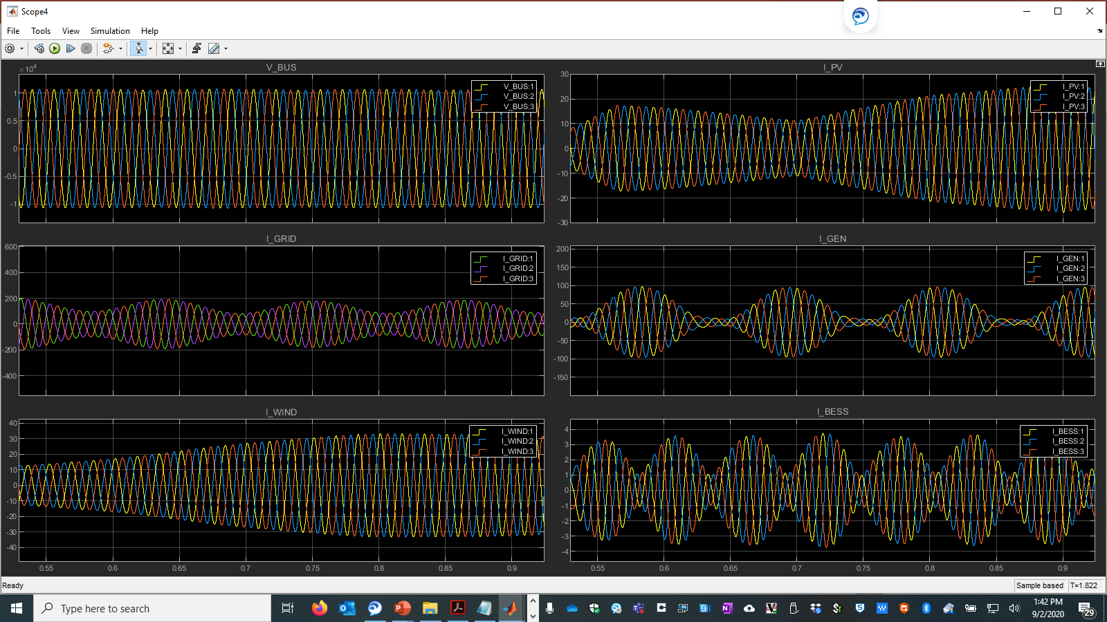
With Genset (Inertia/10) and 3 MW Load

Slide 15
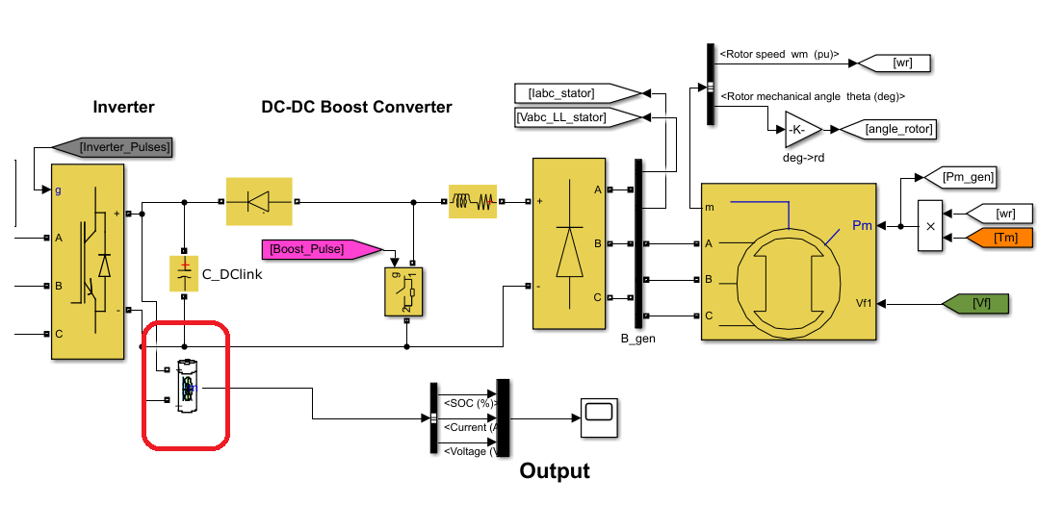
Integrated Storage Sizing?
CART fact sheet.
Model: Westinghouse
Blades: 3
Hub height: 36.6 m
Rotor diameter: 42.6 m
RTD and HIL of CART3:
Nine-bus power system to test inertial control methods.
Field-Testing Using HIL Techniques
https://www.nrel.gov/docs/fy17osti/68137.pdf
Implementation in Microgrid
Grid and Isolated mode ( Load Bank?)
SNL Expertise in this area: HIL (Rachid)
Integrated Storage in DC Link
How it is different from outside the DC link – say at the Inverter Input.
Field Research Validation Sites
https://www.nrel.gov/wind/facilities-research.html

